Slide 1
AXI-SPI Core
Waseem Orphali
Colin Fritz

Slide 2
Outline
1
Project Overview
2
Block Diagram​
3
Requirements​
4
AXI Test Procedures​
5
AXI Simulation Snapshot​
6
SPI Test Procedures
7
SPI Simulation Snapshot
8
Top Entity

Slide 3
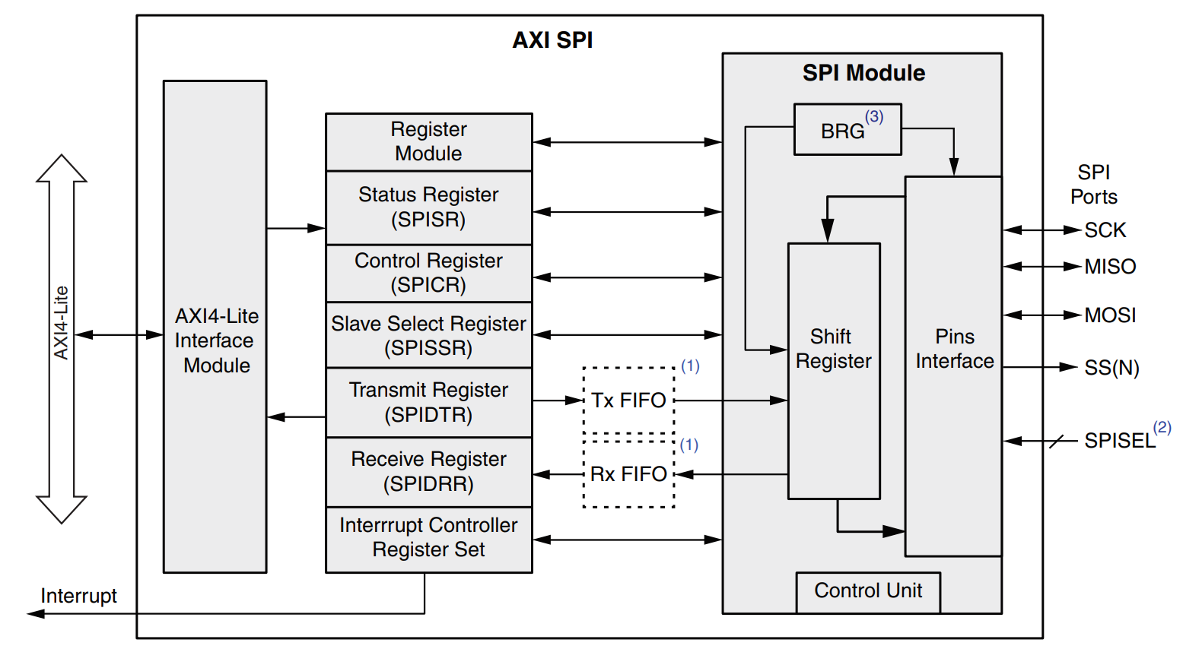
Project Overview

Slide 4
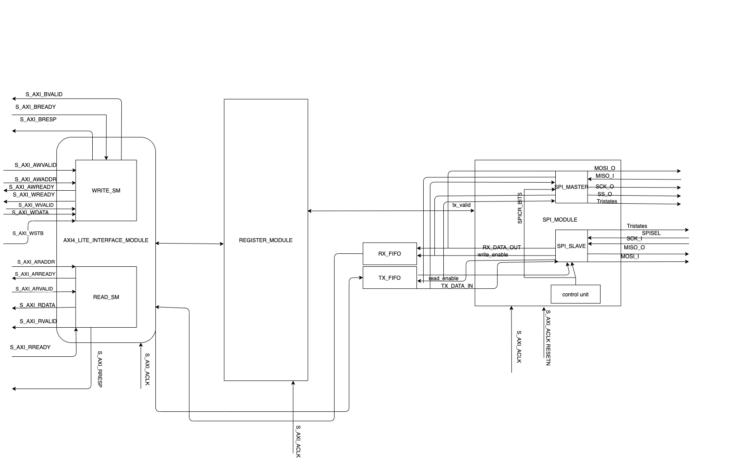
Block Diagram

Slide 5
Requirements
AXI4 LITE Interface transaction.
SPI protocol with CPOL and CPHA 0.
AXI4 interface shall communicate with the Register module via read/write pulses.
Register Module shall return information about the success or failure of individual read and write requests to the AXI Interface.
Read and Write AXI4 Lite transaction shall not occur to the same address within 6 clock cycles of each other.
Register Module components shall be 32 bit.
Register Module shall be read only or update on write according to the data sheet.
SPI Master and Slave shall expect at least 6 clock cycles between transactions.

Slide 6
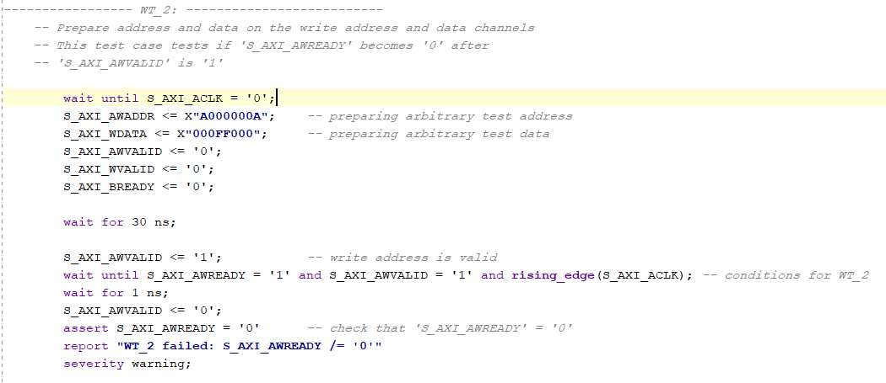
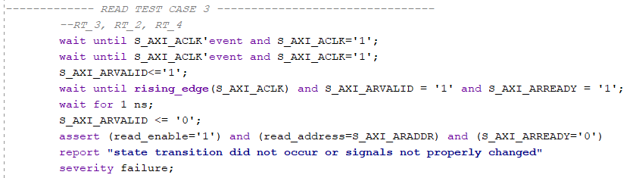
AXI Test Procedures​

Slide 7
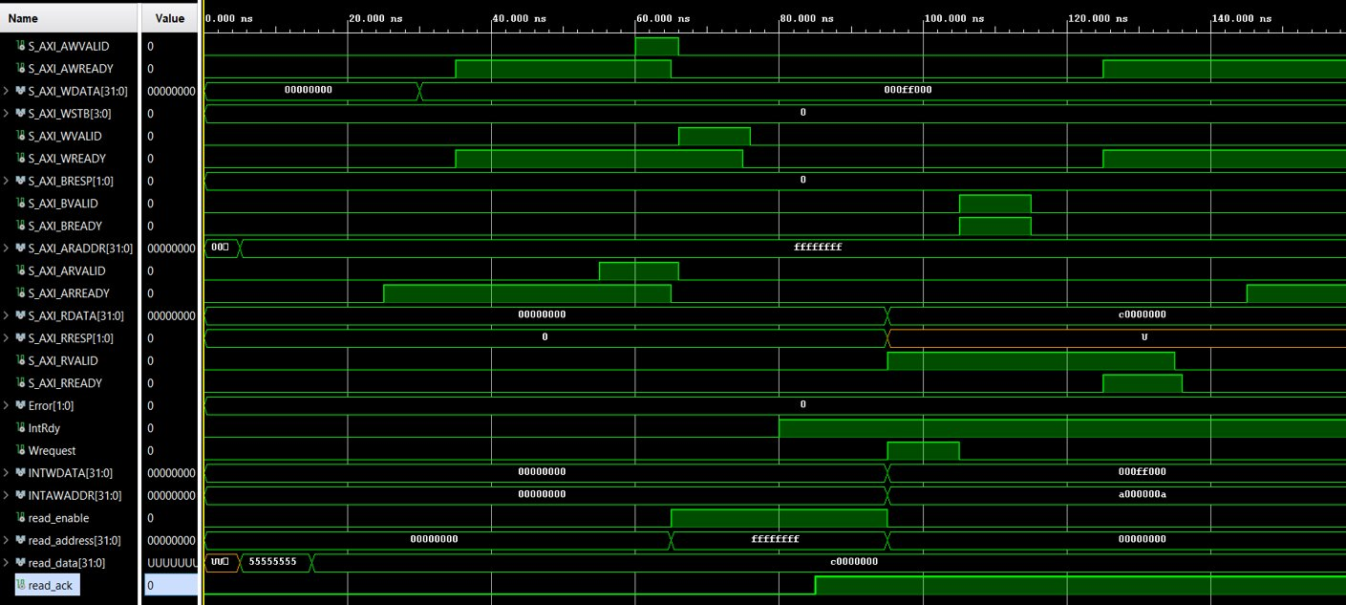
AXI Simulation Snapshot​

Slide 8
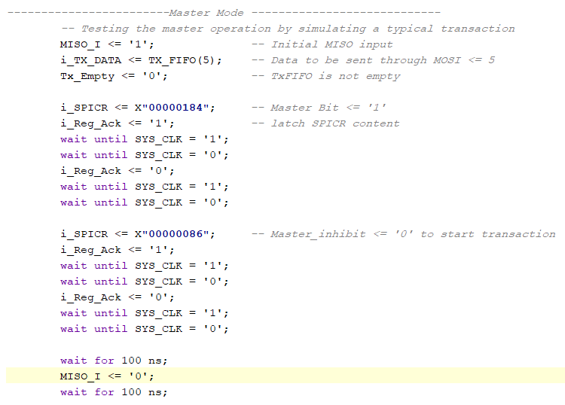
SPI Test Procedures​

Slide 9
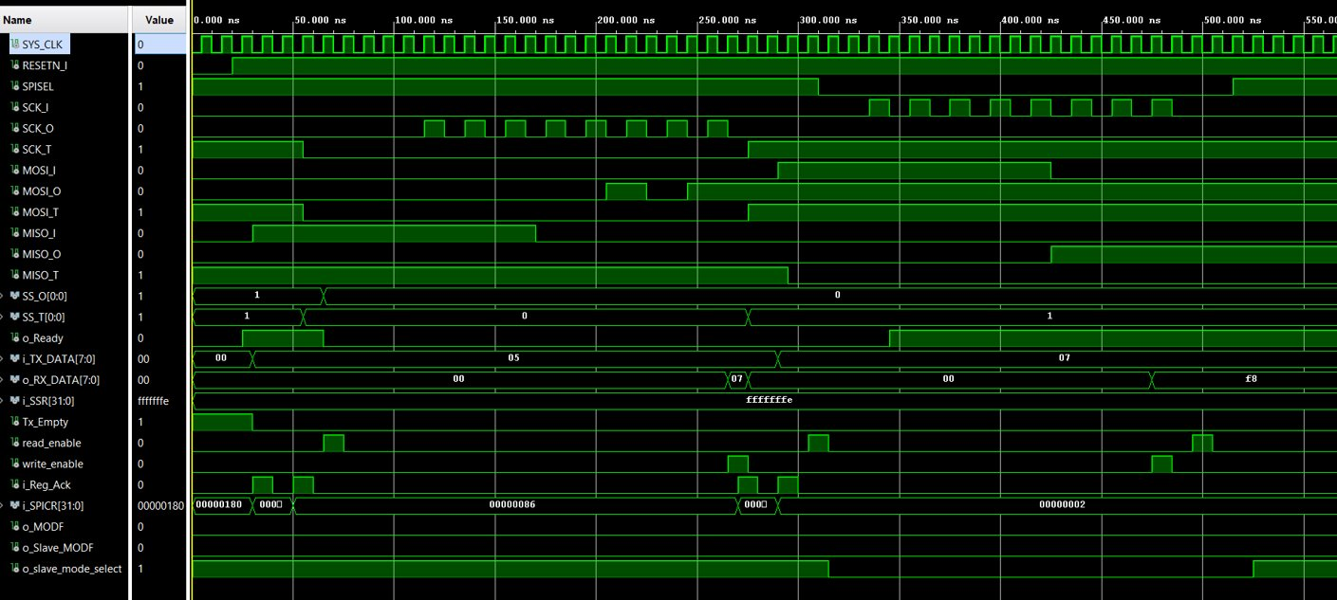
SPI Simulation Snapshot​

Slide 10
Top Entity
Acts as the main controller for the core.
Instantiates the following components:
AXI Module
SPI Module
Register Module
Tx FIFO
Rx FIFO
Interrupt Controller
Coordinates signaling to achieve successful data transfer between AXI and SPI.

Slide 11
Thank You
Waseem Orphali
Colin Fritz

